Slide 1
Testing Session-2

Slide 2
Agenda
Incremental & Iterative Model of SDLC
Agile Process
Testing Methods
White Box Testing
Black Box Testing

Slide 3

Types of SDLC
Incremental/Iterative model
Rapid Application Model(RAD)
Prototype model
Spiral model

Slide 4
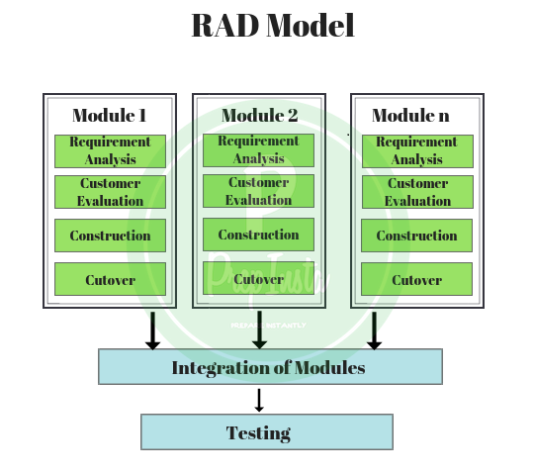
Rapid Application Model
Advantages &
Dis-Advantages of RAD Model

Slide 5
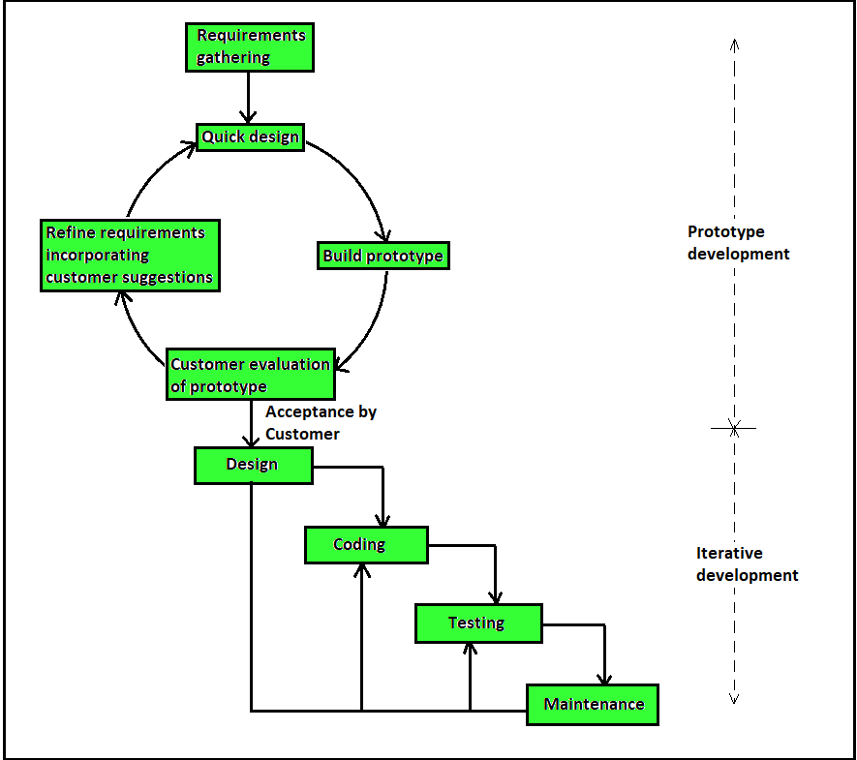
Prototype Model
Advantages &
Dis-Advantages of Prototype Model

Slide 6
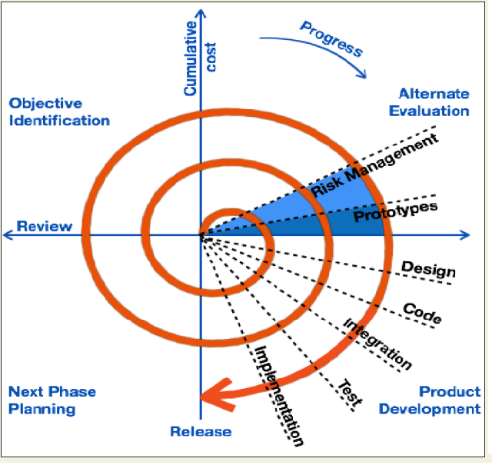
Spiral Model
Advantages &
Dis-Advantages of Spiral Model

Slide 7
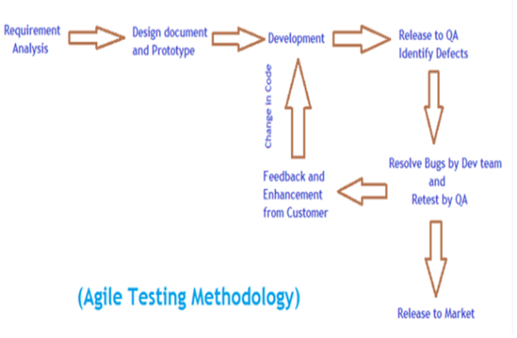

Slide 8
Types of SDLC
Agile Model
Extreme Programming(XP)
DSDM(Dynamic System Development Method)
Kanban
Scrum
Crystal
FDD(Feature Driven Development)
Lean

Slide 9
White Box Testing

Slide 10
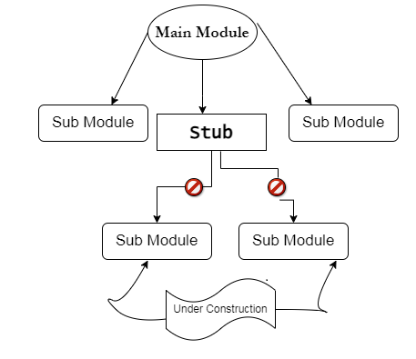
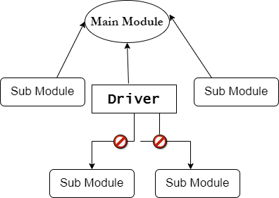
Top Down Approach
Bottom Up Approach

Slide 11
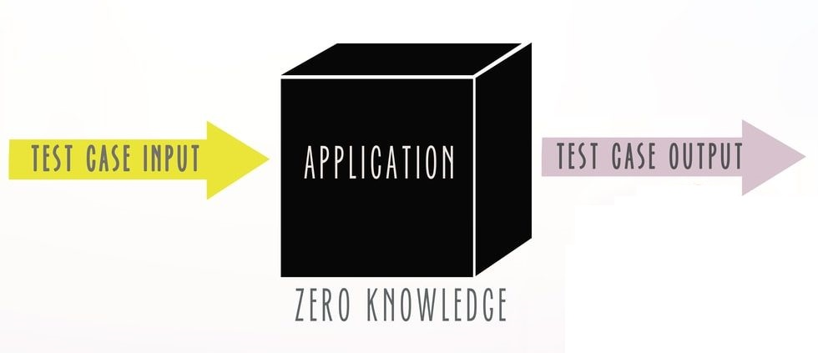
Black Box Testing/System Testing

Slide 12
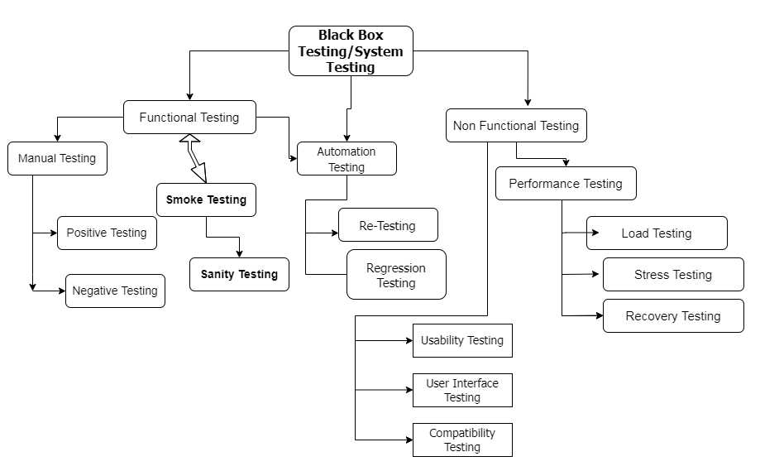

Slide 14
Why Swhizz?
Follow the project-oriented training
One to One monitoring
Work on user stories
Expertise in resume preparation
Mock interviews
Job assistance
Real time people will deliver the classes
Hand on experience.
50+ Client connections for placement

Slide 15
Any Queries?

Slide 16
Thank You
Mr. SubbaRao (Relationship Manager)
Contact:9059002244

